Slide 1
Nanopharmaceuticals Regulatory and Patent Challenges
Srikumaran Melethil, Ph.D., J.D. Registered Patent Attorney Prof. Emeritus, Schools of Pharmacy and Medicine University of Missouri-KC, Kansas City, MO
2nd Sympos​ium on Nanomedicine and Nano​safety
​March 24, 2017​ Colorado Center for Nanomedicine and Nanosafety (CCNN) University of Colorado-Denver

Slide 2
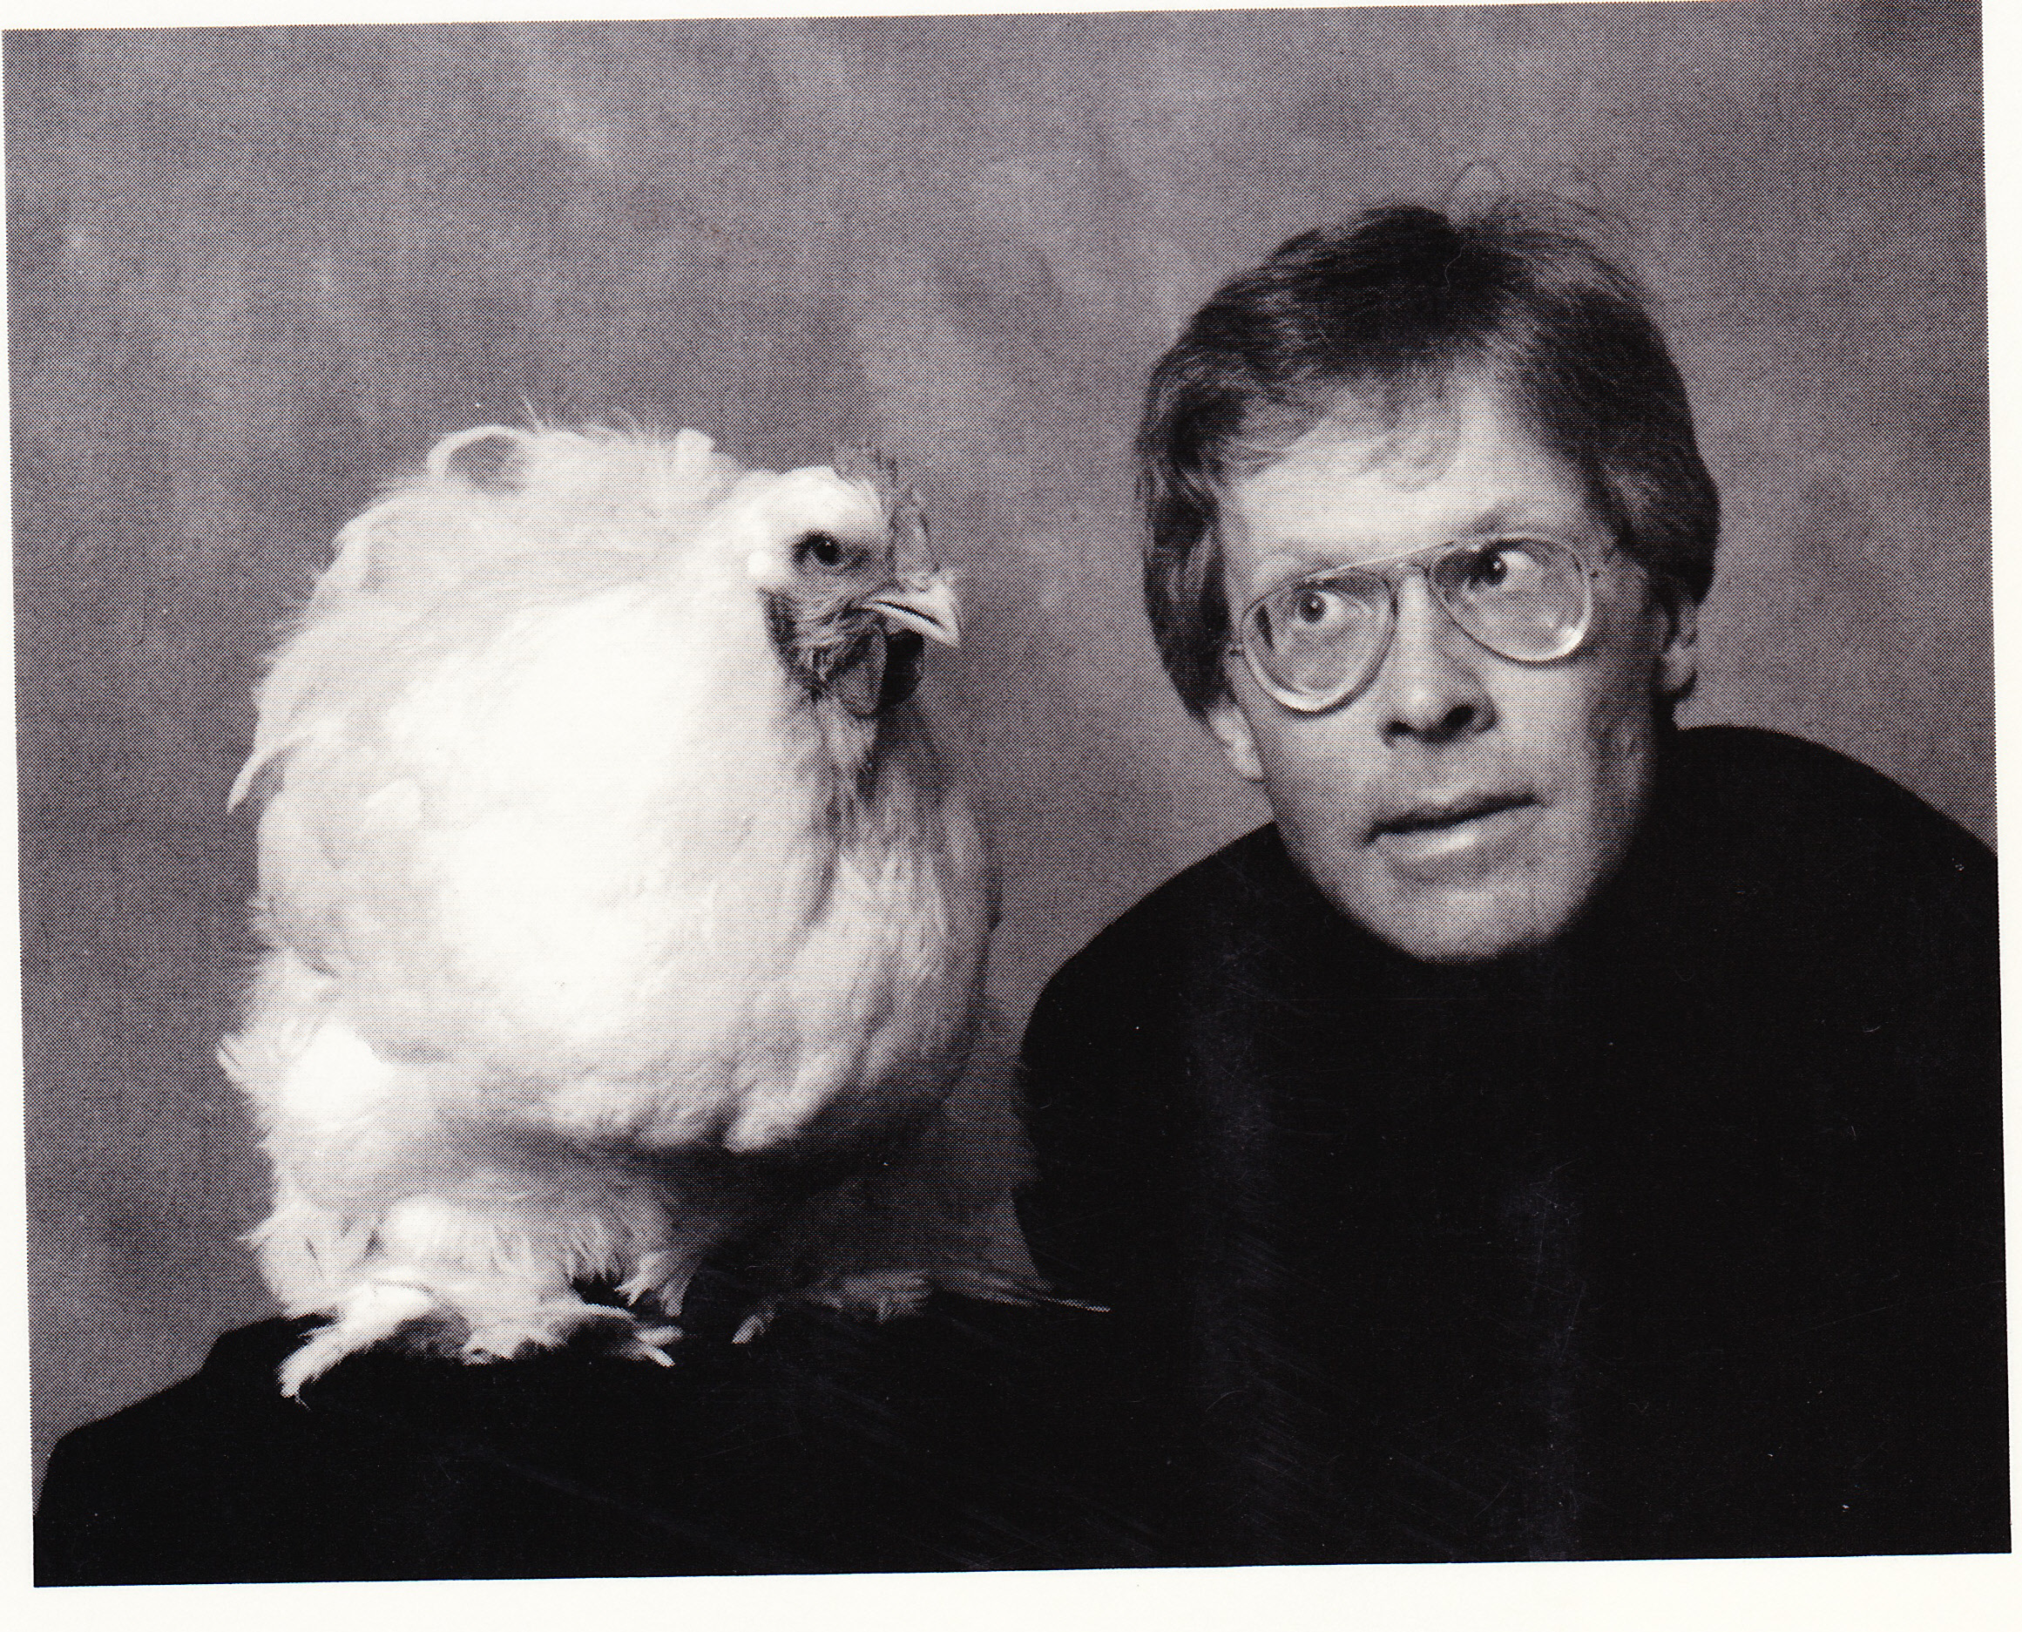
“And it turns out,” Feynman said, “that all of the information that man has carefully accumulated in all the books of the world can be written in a cube of material 1/200 of an inch wide – which is the barest piece of dust that can be made out by the human eye. So, there is plenty of room at the bottom. Don’t tell me about microfilm! - Richard Feynman p. 115/Harris

Slide 3
Objectives
Enable Scientists to Better Capitalize on Their Nanotechnology Inventions Through:
1. Understanding of Regulatory and Patent Issues
2. More Efficient Communication with Their Patent Counsel

Slide 4
“Because there is a general lack of understanding of each culture, these interactions often lead to a cognitive friction that is both disturbing and costly to society.” _______ A Convergence of Science and Law (National Academy Press, 2001) http://books.nap.edu/html/science_law/report.pdf
Nanopharmaceuticals: Where Science and Law Meet

Slide 5
Scientists Invent
Lawyers Patent

Slide 6
Why NanoPharmaceuticals?
More Effective (enhanced target delivery, e.g., tumor)
Less Toxic
Combat Generics

Slide 7
REGULATORY ISSUES

Slide 8
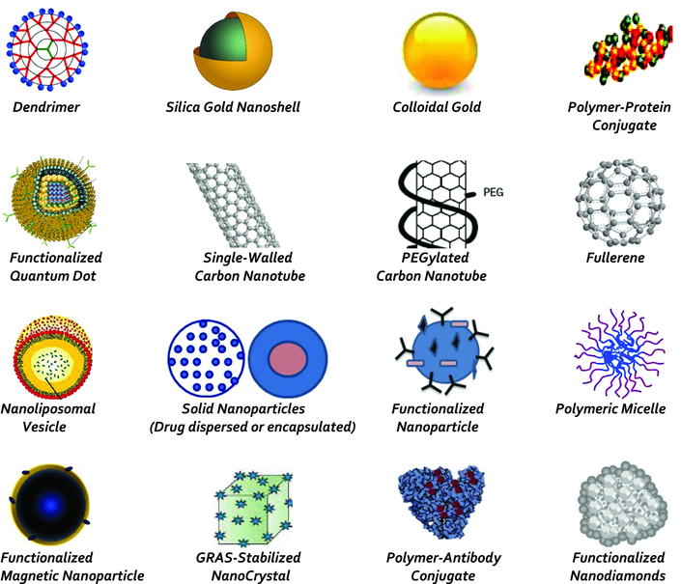
Nanomedicines for Drug Delivery*
*Tinkle et al., NY Acad. Sci 1313, 35-56, 2014
Notes:
Nanopharmacuticals are combination products

Slide 9
“We are now entering an area in which many new areas of biotechnology are focused on combination products, which have little or no precedent for regulators.”
Gail McNaughton, Nature Biotechnology, 19, 709-710, 2001(Aug.)

Slide 10
Tissue Engineering Invention (“biodeviceutical”) US Pat. No. 6,171,610 (issued Jan. 9, 2001)
A method for generating new tissue, the method comprising:
obtaining a liquid hydrogel-cell composition comprising a hydrogel and tissue precursor cells;
delivering the liquid hydrogel-cell composition into a permeable, biocompatible support structure

Slide 11
CombinationProducts
FDA Approval Categories
Drugs - Center for Drug Evaluation and Research (CDER)
Biologics - Center for Biologics Evaluation and Research (CBER)
Devices – Center for Devices and Radiological Health (CDHR)

Slide 12
Mode of Action (21 CFR 3.2 (k))
Mode of action:
“means by which a product achieves an intended therapeutic effect or action.”
"therapeutic" action or effect includes any effect or action of the combination product intended to diagnose, cure, mitigate, treat, or prevent disease, or affect the structure or any function of the body. “

Slide 13
Primary Mode of Action (PMOA)
“the single mode of action of a combination product that provides the most important therapeutic action of the combination product.”*
*(Final Rule, Fed. Reg. August 25, 2005)
Practical Effect: PMOA decides which center gets to review the application

Slide 14
PMOA Examples
Drug Eluting Stent • PMOA – stent opens artery (device) • Secondary MOA – drug prevents inflammation and restenosis • Assigned to CDRH
Drug Eluting Disk • PMOA – chemotherapy for brain tumor (drug) • Secondary MOA – local delivery of drug by the device • Assigned to CDER
https://www.fda.gov/downloads/Drugs/DevelopmentApprovalProcess/SmallBusinessAssistance/UCM293277.pdf

Slide 15
Litigation: Drug or Device (1997)
Plaintiffs:
Bracco Diagnostics, Inc.
DuPont Merck Pharmaceutical Co and Imarx Pharmaceutical Corp.
Sonus Pharmaceuticals
Defendant:
Donna Shalala (Secretary, Human and Health Services)
Product :
All 3 plaintiffs manufacture “[intravenously] injectable contrast imaging agents for use with diagnostic ultrasound equipment in the diagnosis of cardia dysfunction.”
“Each product contains fluorinated gas (perflouropropane) encapusulated in a microsphere membrane or microtuble”

Slide 16
Litigation: Drug or Device (1997) (cont’d)
Product:
All 3 plaintiffs manufacture “[intravenously] injectable contrast imaging agents for use with diagnostic ultrasound equipment in the diagnosis of cardia dysfunction.”
“Each product contains fluorinated gas (perflouropropane) encapusulated in a microsphere membrane or microtuble”

Slide 17
Litigation: Drug or Device (1997) (cont’d)
Plaintiffs three products were classified as new drugs while a “virtually identical product” of a competitor (Molecular Biosystems, Inc.) was classified a device.
The Court ruled in favor of the plaintiffs who wanted their products to be classified as devices. The Court chastised the FDA for its “disparate treatment of functionally indistinguishable products” as “arbitrary and capricious” because the FDA did not provide “a rational basis” for the separate classifications of these products.

Slide 18
Litigation: Drug or Device (1997) (cont’d)
The Court ruled in favor of the plaintiffs who wanted their products to be classified as devices. The Court chastised the FDA for its “disparate treatment of functionally indistinguishable products” as “arbitrary and capricious” because the FDA did not provide “a rational basis” for the separate classifications of these products.
Notes:
FDA has the right to classify, but must do it uniformly

Slide 19
PATENT ISSUES

Slide 20
How to get a patent on an invention?
Criteria | Patent Statute (35 U.S.C.)
Utility | §101
Novelty | §102
Non-obviousness | §103 (“PHOSITA”)
Enablement | §112
R. Bawa, S. Melethil, W.J. Simmons and D. Harris, The SciTech Lawyer Fall 2008

Slide 21
Which word is open to interpretation?
Claim 2.
A touch probe . . . the probe generating a trigger signal when said sensing tip contacts an object . . .
(Touch Probe, US patent 5,491,904)

Slide 22
Which word is open to interpretation?
Claim 2.
A touch probe . . . the probe generating a trigger signal when said sensing tip contacts an object . . .
[Renishaw PLC v. Marposs Societa’ Per Azioni 158 F.3d. 1243(Fed. Cir. 1998)]

Slide 23
Meaning of words big part of patent disputes
Fighting Words

Slide 24
Abraxane

Slide 25
Nanoparticle Albumin-bound (nab) platform technology
Albumin
Active drug in nanoparticle
is in non-crystalline, amorphous, readily bioavailable state
Mean size:50-150 nm
Concentration dependent dissociation into individual drug-bound albumin molecules
Hydrophobic drugs, e.g.,Paclitaxel, docetaxel, rapamycin etc.

Slide 26
Abraxane versus Taxol (3 week treatment)
Drug | Dose (mg) | Tumor Size | Tumor in “check” (weeks) | NP (%) | Neuropathy (# of patients)
Abraxane (130 nm) | 260 (30 min) | 33% | 21.9 | 34 | 24
Taxol * | 175 (3 hr) | 19% | 16.1 | 54 | 5
* : dissolved in Cremophor NP= neutropenia

Slide 27
FDA
“Taxol has a higher incidence of neutropenia and hypersensitivity reactions”
“Abraxane has a higher incidence of peripheral neuropathy, nausea, vomiting, diarrhea and asthenia”

Slide 28
FDA (cont’d)
“FDA agrees that in the metastatic breast cancer study Abraxane had a higher tumor response rate than Taxol”

Slide 29
Abraxane versus Taxol
http://www.youtube.com/watch?v=OmRzyqc6QrA

Slide 30
Elan Pharmaceutical v. Abraxis Biosciences

Slide 31
The jury determined that Abraxane infringed on several of Elan's patent claims in U.S. Patent No. 5,399,363 ('363 Patent), 142 issued by the USPTO in 1995. The Elan '363 Patent claimed anticancer compositions in the form of "surface modified nanoparticles" in "crystalline" form that "exhibit reduced toxicity and/or enhanced efficacy." 143 The Elan Patent specifically claimed:
Particles consisting essentially of 99.9% by weight of a crystalline medicament useful in treating cancer susceptible to treatment with said medicament, said medicament having a solubility in water of less than 10 mg/ml, and having a non-crosslinked surface modifier adsorbed on the surface thereof in an amount of 0.1-90% by weight and sufficient to maintain an average effective particle size of less than 1000 nm ... .144

Slide 32
Elan Patent
The Elan Patent specifically claimed:
Particles consisting essentially of 99.9% by weight of a crystalline medicament useful in treating cancer susceptible to treatment with said medicament, said medicament having a solubility in water of less than 10 mg/ml, and having a non-crosslinked surface modifier adsorbed on the surface thereof in an amount of 0.1-90% by weight and sufficient to maintain an average effective particle size of less than 1000 nm

Slide 33
Surface modified anticancer nanoparticles (Elan’s US Patent (1995))
Claim 1
Particles consisting essentially of 99.9% by weight of a crystalline medicament useful in treating cancer susceptible to treatment with said medicament, said medicament having a solubility in water of less than 10 mg/ml, and having a non-crosslinked surface modifier adsorbed on the surface thereof in an amount of 0.1-90% by weight and sufficient to maintain an average effective particle size of less than 1000 nm . . .

Slide 34
Markman Hearing * Claim Construction Hearing
1 Pretrial hearing in a U.S. District Court (where the patent litigation begins)
2. Judge determines the appropriate meaning of key words based on evidence presented by the parties involved (“bench trial”, i.e., no jury)
Markman v. Westview Instruments, Inc., 517 U.S. 370 (1996),

Slide 35
Markman Hearing (cont’d)
The term “adsorbed on the surface” is construed to mean “a molecule retained at the surface of the crystalline medicament that does not chemically bond with such medicament
The term “surface modifier” is construed to mean “a substance that modifies the surface properties of the crystalline medicament.”

Slide 36
Can I Patent My Research Results?

Slide 37
Example: BBB Drug Transport

Slide 38
FACTORS AFFECTING NANOPARTICLE DISPOSITION
SIZE
SHAPE (geometry)
SURFACE PROPERTIES (charge)

Slide 39
Doxorubicin-loaded Nanoparticles [Steiniger et al, Int. J. Cancer., 109 , 759-767, 2004]
Unique Properties of Nanoparticles
Polysorbate 80-coated poly (butylcyanoacrylate) doxorubicin nanoparticles
Mean diameter (± SD): 270 ± 20 nm
Nanoparticle content in suspension : 70%

Slide 40
Doxorubicin-loaded Nanoparticles [Steiniger et al, Int. J. Cancer., 109 , 759-767, 2004]
Unique Properties of Nanoparticles

Slide 41
Mechanisms Involved [Steiniger et al, Int. J. Cancer., 109 , 759-767, 2004]
Endocytosis (LDL receptor mediated)
Apolipoprotein B
Apolipoprotein E

Slide 42
BBB transport: Dalargin

Slide 43
Nociceptive Threshold (% MPE, mean ± SD) after i.v. injection of dalargin-loaded polysorbate 80 pre-coated PBCA nanoparticles (NPs) in mice
Apolipoprotein (ALP) was coated onto the surface of the pre-coated NPs
ALP | 15 min | 30 min | 45 min | 60 min | 90 min
Control | 35.2 ± 5.8 | 50.4 ± 4.1 | 49.5 ± 4.5 | 36.5 ± 13.7 | 7.10 ± 6.3
Apo B | 30.9 ± 19.4 | 74.7 ± 15.8* | 58.7 ± 8.03* | 45.1 ± 18.6 | 25.5 ±16.4
Apo E | 61.4 ± 8.59* | 62.1 ± 6.91 | 64.5 ± 14.0 | 62.3 ± 11.8* | 51.7 ± 12.9*
Apo AII | 1.98 ± 9.56 | 0.50 ± 10.58 | 12.81 ± 16.8 | 18.29 ± 21.81 | 48.8 ±13.24*
*p < 0.05
Kreuter et al., J. Drug Targeting 10, 317-325 (2002)

Slide 44
Searching US Patent Collection...
Results of Search in US Patent Collection db for: IN/kreuter-jorg: 6 patents. Hits 1 through 6 out of 6
 | PAT. NO. |  | Title
1 | 8,003,128 |  | Polylactide nanoparticles
2 | 6,288,040 |  | Medicament excipient particles for tissue-specific application of a medicament
3 | 6,165,988 |  | Medicament in particulate form
4 | 6,117,454 |  | Drug targeting to the nervous system by nanoparticles
5 | 4,269,821 |  | Biological materials
6 | 4,225,581 |  | Biological materials

Slide 45
Carbon Aerogel World’s Lightest Material
“. . . a quantity of aerogel equal in volume to a typical human body would weigh only . . . 1/40th of a pound.”
http://www.huffingtonpost.com/2013/04/02/lightest-material-earth-carbon-aerogel_n_2980978.html

